Slide 1
3 - Scenarios
Exploring Data Geographically

Slide 2
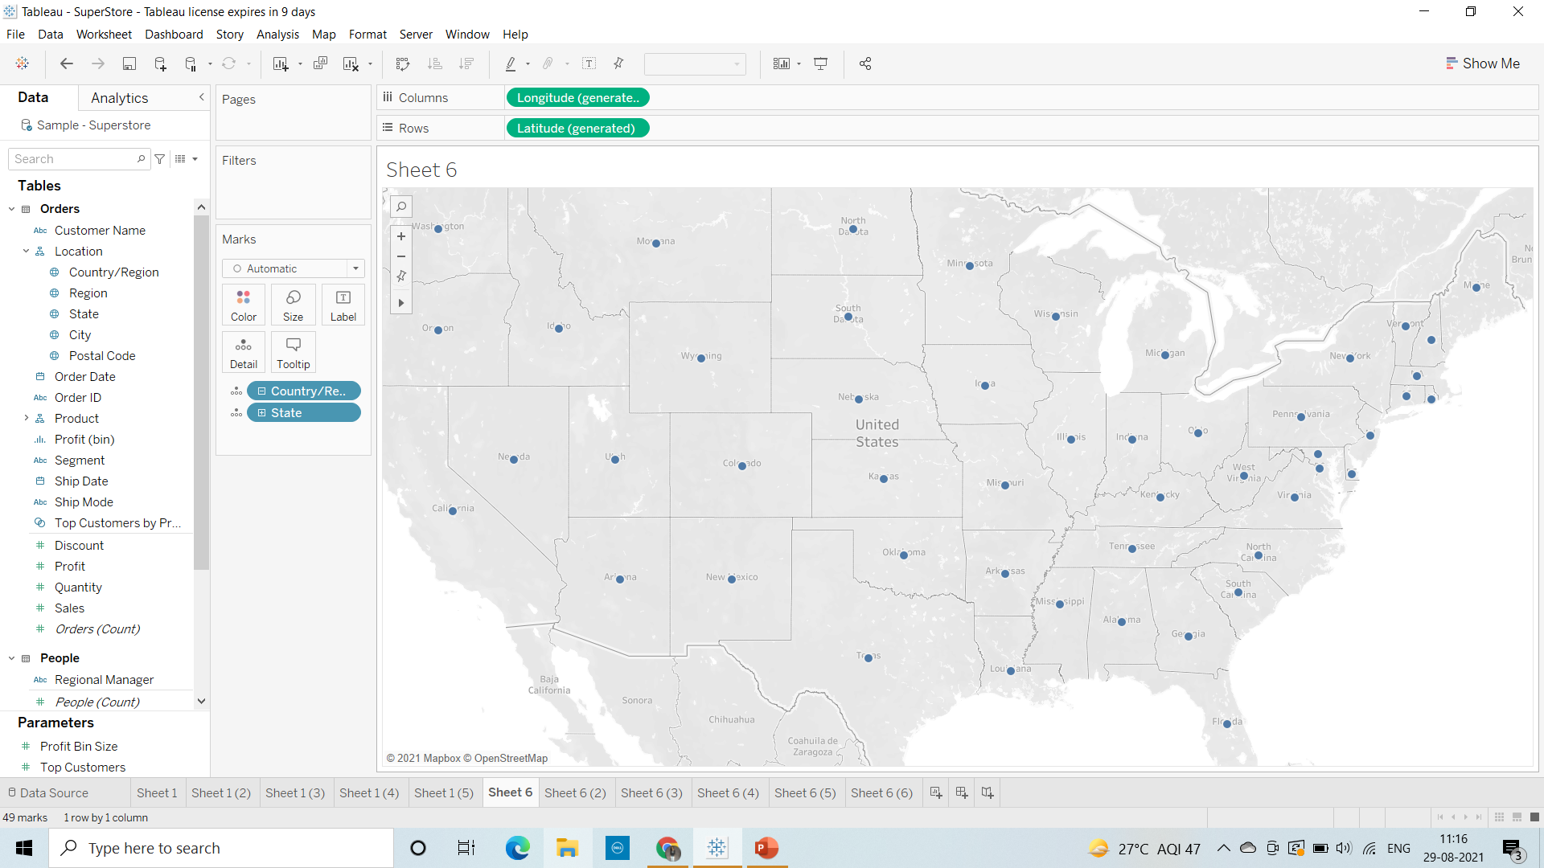
Scenarios: Exploring Data Geographically
1. Create a Map view to represent all the states with country.

Slide 3
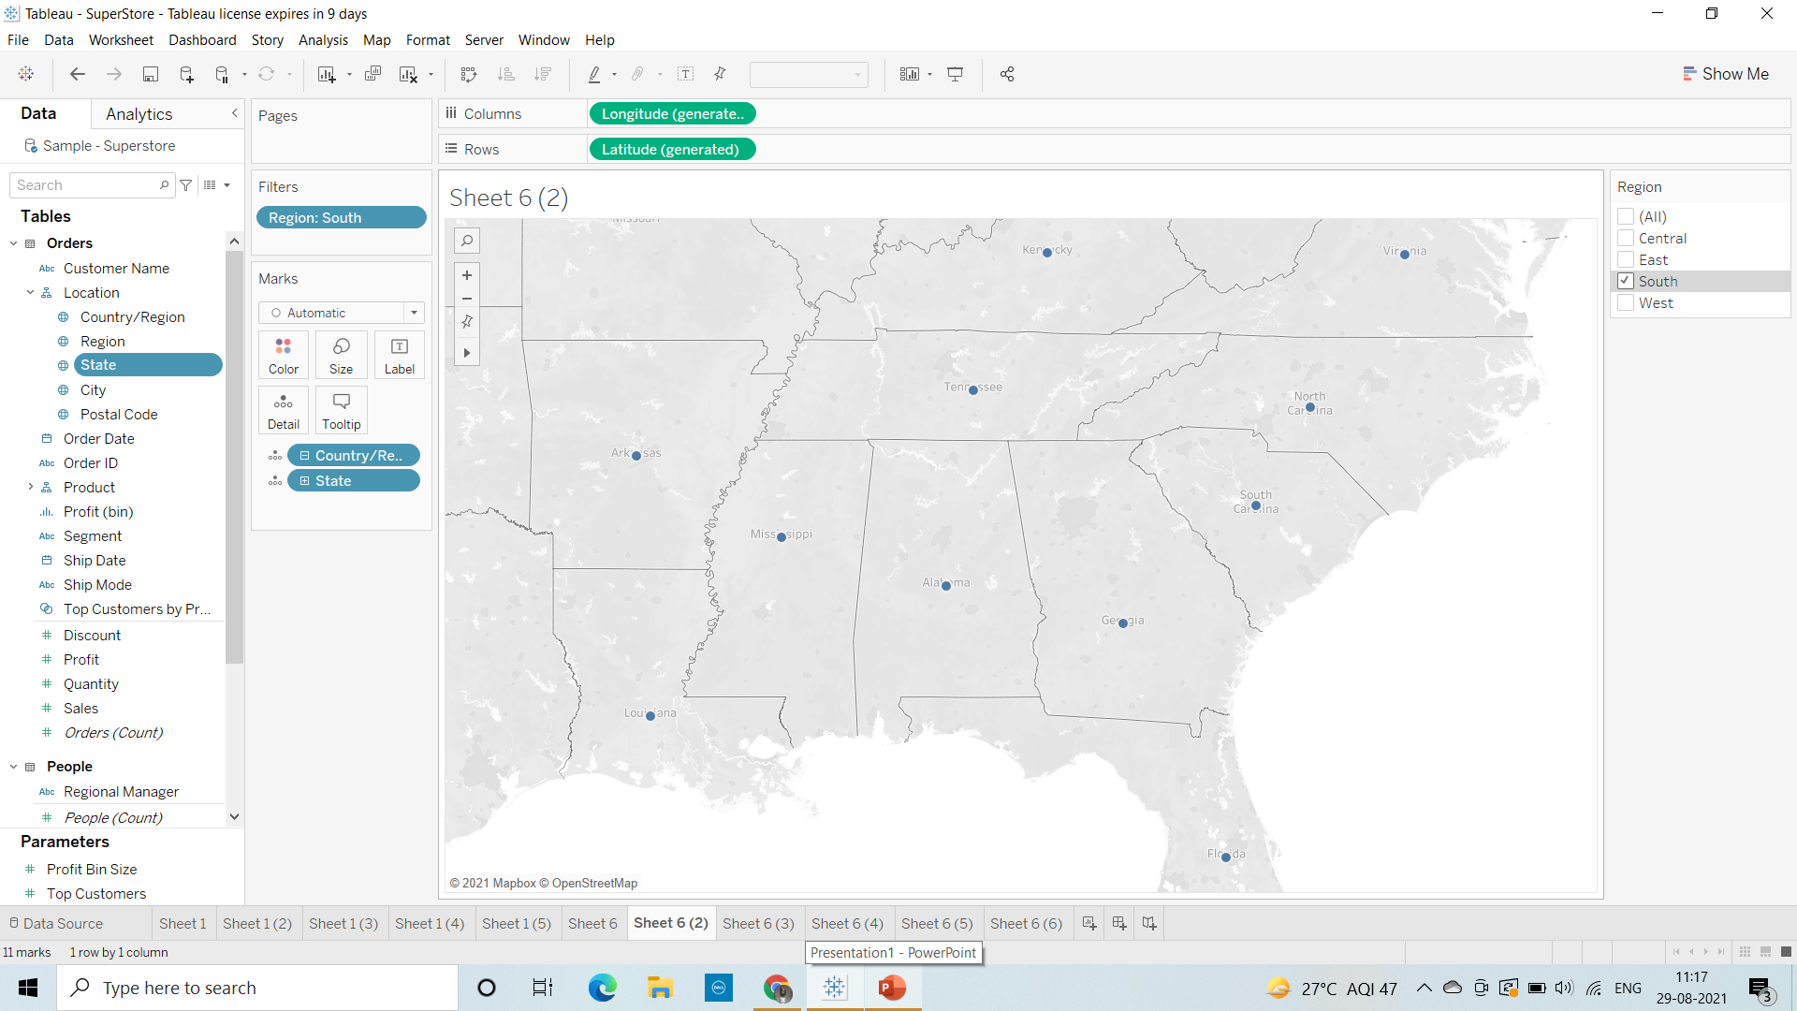
2. Check your map for south region.

Slide 4
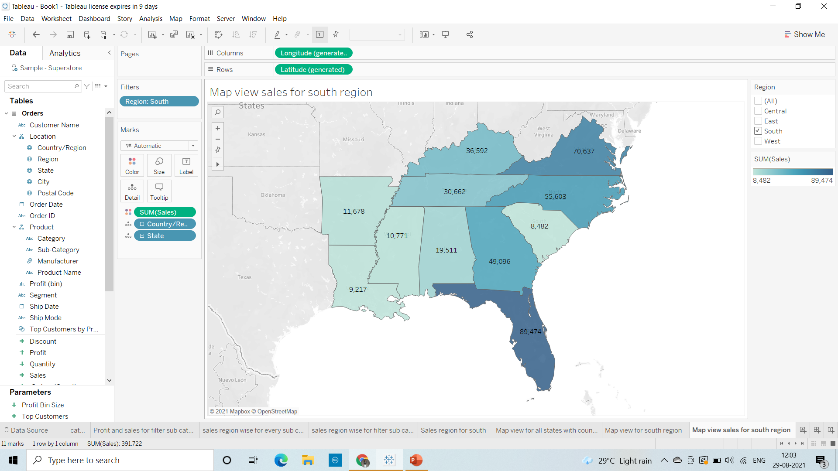
4. Check the sales for south region.

Slide 5
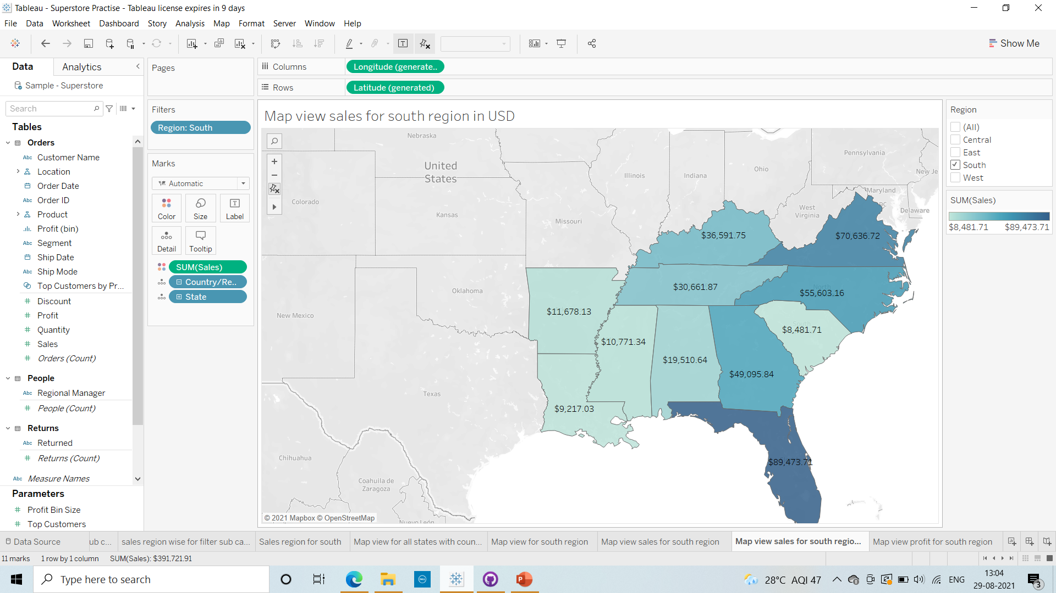
5. Find the state that has highest sales. For Florida state it is showing highest sales
6. Represent your sales in USD.

Slide 6
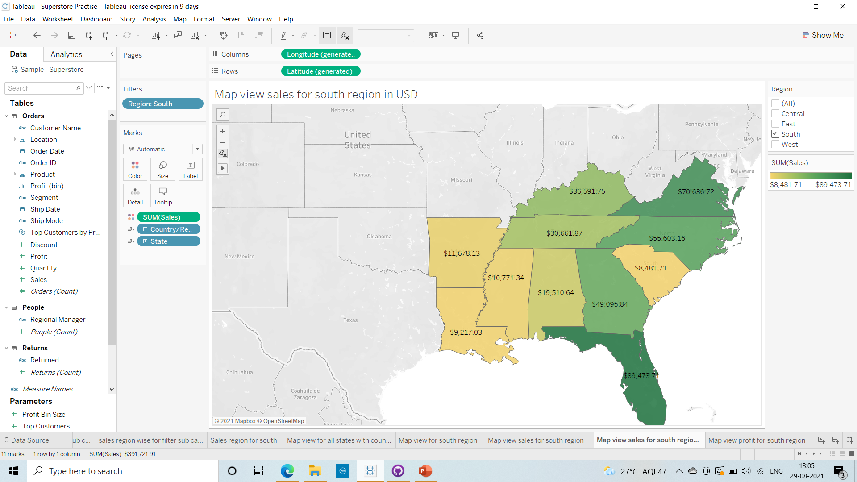
7. Edit color for you map.

Slide 7
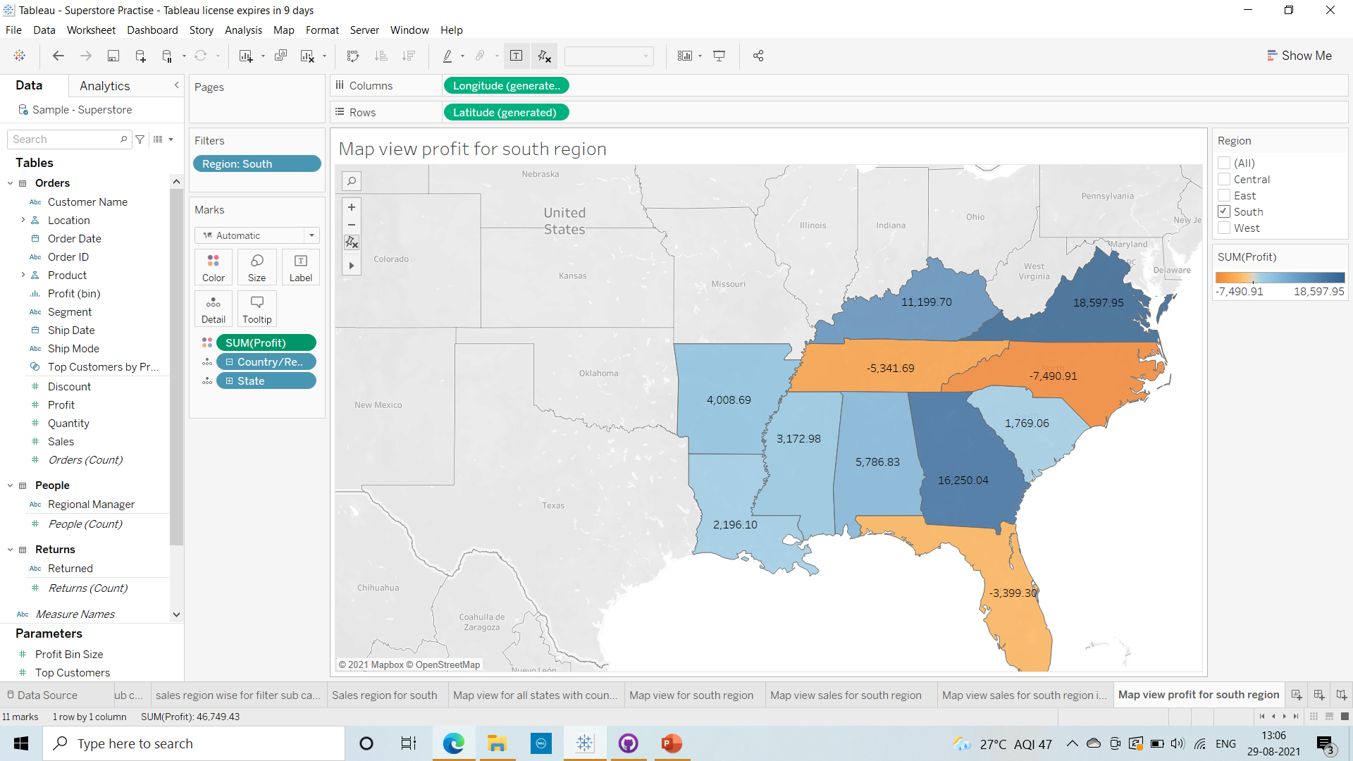
8. Show profit for all the states in your map in south region.

Slide 8
9)Find out the name of some states having negative profit\
Tennessee, North Corolina, Florida
10.Note down the name of the states having lowest profit and highest profit.
Highest profit states: Virginia
Georgia
Kentucky
Lowest Profit states: Tennessee
North Corolina
Florida
© 2021 GitHub, Inc.

